Slide 1
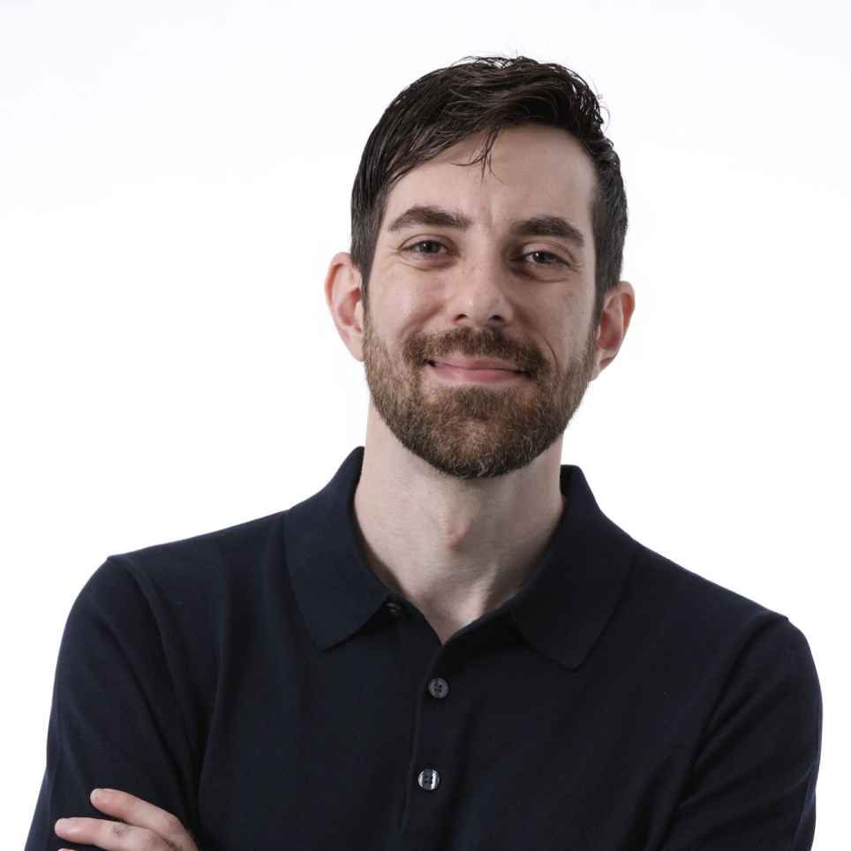
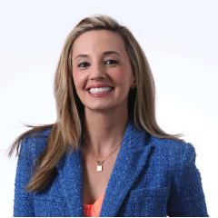

Alyssa Martin Vice President Experiences
Email
Alyssa.martin@thebridge.com
Location
Dallas, Texas
Mobile
(469-510-7171
Alyssa has been working with clients to solve their most complex challenges through the vehicle of end-to-end experience design for more than 14 years. From Fortune 10 companies to groundbreaking startups, Alyssa has led strategy-to-execution projects at scale inside of the creative agency, startup, and management consulting environments – guiding clients and teams to award-winning outcomes. Her approach almost always involves challenging clients to think BIG, prioritize what’s possible, and then accelerate progress to realized value. Alyssa specializes in building and leading high-performing teams to maximize value … all while prioritizing integrity, kindness, and humor to ensure a positive experience for all.
EXPERIENCE
Industry Experience
Healthcare, Retail, Financial Services, Gaming, Advocacy, Automotive
INTEGRIS Health
Led the research and strategy workstream for a 12-month digital unification project for the largest not-for-profit healthcare system in the state of Oklahoma.
TAKE COMMAND Health
Led go-to-market strategy – inclusive of persona development, journey mapping, brand, and design systems – for a SaaS health insurance platform.
STARBUCKS Coffee
Led work plan strategy for Starbucks’ mobile loyalty program working hand-in-hand with internal research and testing teams to maximize volume.
AWARDS & CERTIFICATIONS
SKILLS
Consulting Magazine 2022 Women Leaders in Technology Honoree
CHIEF Member
Service Design Dallas Member
Dallas Entrepreneurial Center Board Member & Mentor
Dallas Startup Week Leadership Committee Advisor
Experience Design Strategy, Creative Services Strategy, Program Leadership, Portfolio Management, Client Leadership, Team Leadership

